Slide 1
Unit Tests

Slide 2
Today’s topic – TESTING
How did you test your code until now?

Slide 3
Testing is an essential part of software development
Different phases of testing have different names:
Unit testing is the test of a class, routine or small program, written by one or a few people;
Integration testing tests the interaction of two or more subsystems;
Regression testing is iterated testing of software after bug fixes or changes – to ensure the same bug doesn’t happen again; Makes sure everything is working the same as before;
System testing tests the complete SW deliverable in its final form
There are a few more, but these are the main ones

Slide 4
Testing is an essential part of software development
Different phases of testing have different names:
Unit testing is the test of a class, routine or small program, written by one or a few people;
Integration testing tests the interaction of two or more subsystems;
Regression testing is iterated testing of software after bug fixes or changes – to ensure the same bug doesn’t happen again; Makes sure everything is working the same as before;
System testing tests the complete SW deliverable in its final form
There are a few more, but these are the main ones
Developer Testing
Sometimes Developer Testing Too

Slide 5
A fundamental of being a software professional is doing everything possible to deliver quality code
If you have not tested your software, or if it has not successfully passed your tests, you are not done.

Slide 6
Developer testing involves writing some extra code to "exercise" the deliverable pieces and to check their performance
Tests are based on the requirements
If the specs say a method will return a sorted list, then check the return order.
Tests should explore the extent and the bounds of the "parameter space"
If a routine should work for input from 0 to 100, then you'd better try the values 0 and 100 (boundary values)
But, that's not all you try
You need to test the correctness of each line of code (what does this mean?)
all control flows should be tested
all pieces of functionality

Slide 7
Exhaustive testing can be just that; we need to use some tricks to test well
Select the test cases likely to cause errors
boundary values
NULL values
special values for related components
random values
Write your tests first – and add to them later
writing the code can give insight into trouble spots
structured basis testing – write tests to verify all statements in the program, with a minimal set of tests

Slide 8
How many test cases would we need for a routine or a section of code?
1 for the default path (Happy case ☺) through the routine
Add 1 for each control keyword:
- if - while - exceptions - else - switch case
This is a minimum, and the test cases must be designed to exercise all paths.
The idea is to have enough test cases to guarantee we don't ignore any portion of the routine.

Slide 9
JUnit – testing framework for Java
Used to write and run repeatable automated tests
JUnit is widely used in industry
Integrated with IDEs (Eclipse, IntelliJ, etc)

Slide 10
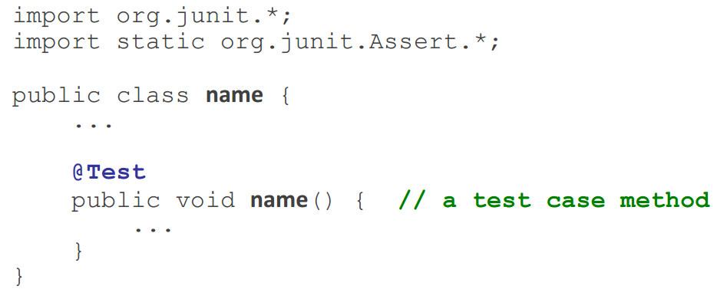
JUnit Test Class
A method with @Test is flagged as a JUnit test case
All @Test methods run when JUnit runs your test class.

Slide 11
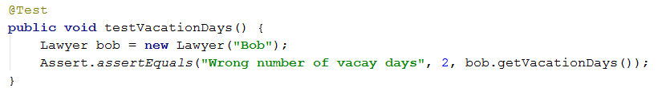
Example Test Case
Assertion methods check things you expect to be true
assertEquals(message, expected, actual)
Fails if the values are not equal and prints the message.
Passes if expected value and actual value are equal
Message is optional. You can simply use assertEquals(expected, actual)

Slide 12
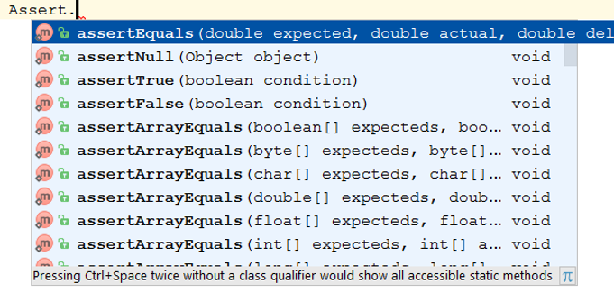
Junit Assertion Methods
Assertion Method | Description
Assert.assertTrue(condition); | Check if condition is true
Assert.assertEquals(expected, actual); | Check if expected and actual are equal
Assert.assertFalse(condition); | Check if condition is false
Assert.assertNull(object); | Check if object is null
Assert.assertNotNull(object); | Check if object is not null
Assert.assertNotEquals(expected, actual); | Check if expected and actual are not equal
These are the main ones. There are more...
Tip: You can press CNTRL-Space for auto-complete and to find methods offered by a class

Slide 13
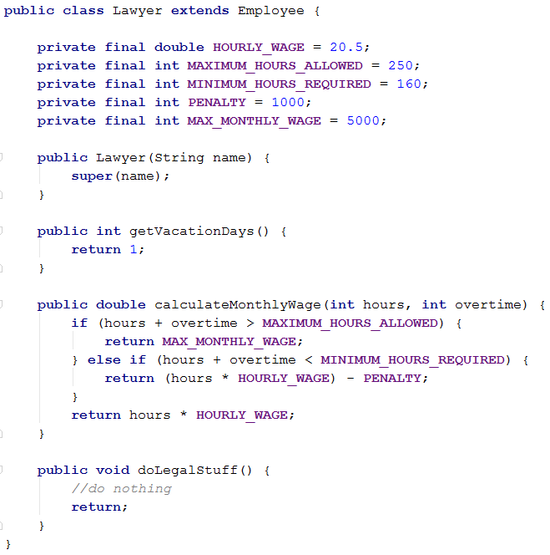
Example

Slide 14
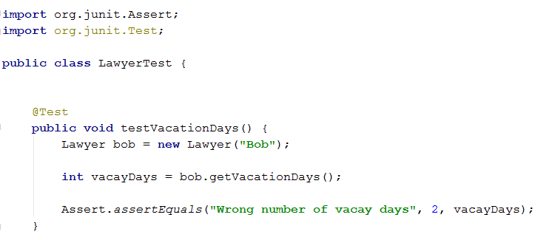
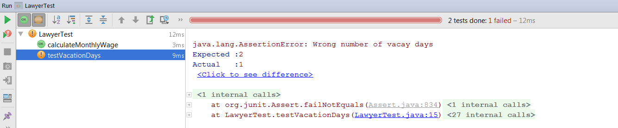
Junit Test

Slide 15
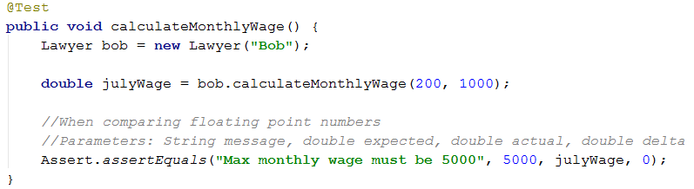
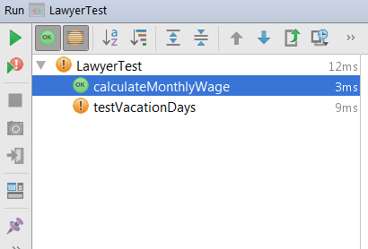
Junit Test 2

Slide 16
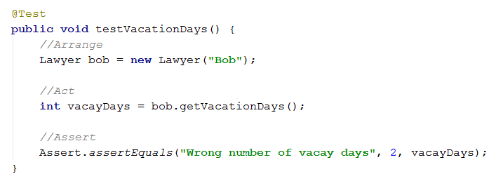
Structure of Unit Tests – AAA Style
Arrange: setup everything needed for the running the test.
Act: Invoke the code under test.
Assert: Specify the pass criteria for the test.

Slide 17
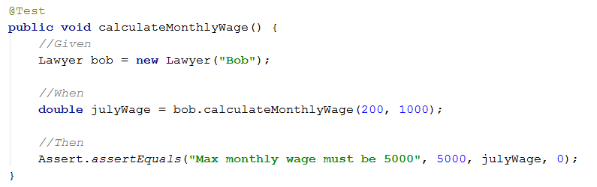
Structure of Unit Tests – GivenWhenThen Style
Given is the set-up, define pre-conditions for the test.
When statement performs the action being tested.
Then statement checks that the post condition holds by asserting values.

Slide 18
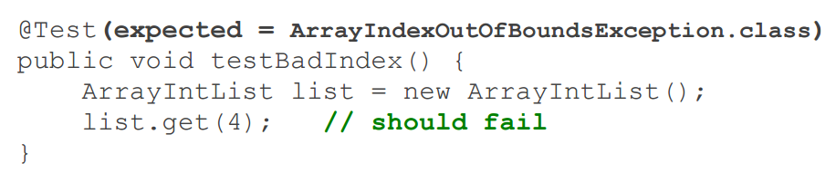
Testing for exceptions
Test passes if it does throw the given exception
If the exception is not thrown, the test fails.
Use this to test for expected errors

Slide 19
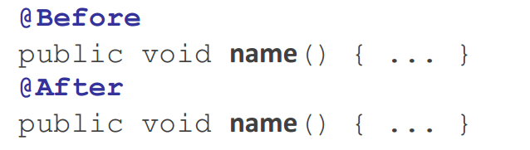
Setup and teardown
Before method runs before each test case is called
For Set-Up
After runs after each test case is called
For Teardown

Slide 20
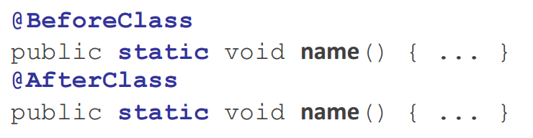
Setup and teardown
BeforeClass runs the associated method once before the entire test class runs
AfterClass runs the associated method once after the entire test class runs

Slide 21
Tips For Testing
You cannot test every possible input, parameter value, etc.
So you must think of a limited set of tests likely to expose bugs.
Think about boundary cases
positive; zero; negative numbers
right at the edge of an array or collection's size
Think about empty cases and error cases
0, -1, null; an empty list or array
Test behavior in combination
maybe add usually works, but fails after you call remove
make multiple calls;
maybe size fails the second time only

Slide 22
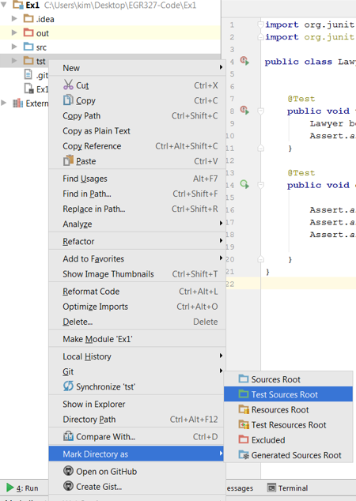
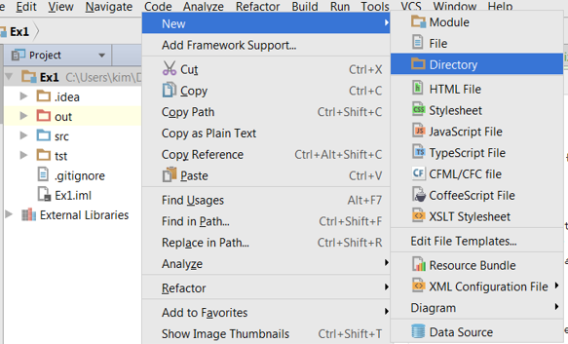
Setting Up Test Folder – IntelliJ
Step 1)
Create a test folder “tst”
Step 2)
Make “tst” folder a Test Sources Root
Step 3)
Create a Java Class under “tst” folder

Slide 23
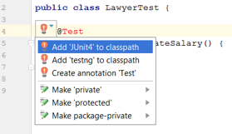
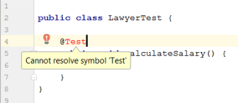
Setting Up Junit – IntelliJ
Step 1) Create a new class under “tst” folder called LawyerTest.java
Step 2) Write a test method – just the signature for now
Step 3) Import Junit4 to your project
You can hit “Alt-Enter” to bring the options as well (when you have any error in RED)

Slide 24
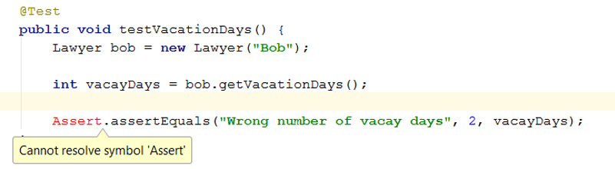
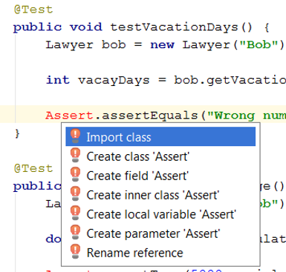
Write Tests
Alt-Enter to find proper class to import

